Slide 1
Cognitive Behavioral Therapy – Smoking Cessation Bot
Aug 2021
Team MonAmi:
Abhishek Chowdhury
Rakhee Srivastava
Debabrata Behera

Slide 2
“Counselling and other types of emotional support can boost success rates higher than medicines alone”. - ACA
© 2021 Optum, Inc. All rights reserved. Confidential property of Optum. Do not distribute or reproduce without express permission from Optum.

Slide 3

The need for CBT in smoking cessation
With only 3% of average quit rate for smokers each year, breaking this habit is difficult…
Traditional quit methods come with a variety of side effects:
Gastric issues
Difficulty sleeping
Zyban
Distress
NRT
Nausea
E-Cigs
Headaches
Chantix
Rash
Willpower alone
Respiratory issues
Withdrawal symptoms
It’s more effective to switch from physical side of smoking to the psychological side of addiction!
Cognitive behavior therapy
Can be the choice of treatment to quit effectively
CBT focuses on the thoughts about smoking and quitting so that one can replace negative thoughts with those more positive and encouraging.
© 2021 Optum, Inc. All rights reserved. Confidential property of Optum. Do not distribute or reproduce without express permission from Optum.

Slide 4






MonAmi!
Our Solution
A highly intuitive and advanced cognitive bot that works on CBT to simulate the human thought process in complex situations, where the answers may be ambiguous and uncertain.
The bot is designed to provide an evidence-based intervention to identify, focus and target the key triggers and negative thoughts and urges - to smoke and changes those to ultimately result in positive behavioral changes over daily chat session.
Cognitive Computing
Human Machine Interaction
Rewiring the Negative Thoughts to Positive Behavior
Daily CBT sessions
Evidence based approach
Applied CBT techniques
Daily interactions
Personalized experience*
Azure Cognitive Services
Luis + QnA Maker
GraphQL
Your Cognitive Companion
*Users' specific answers as the basis to ask targeted questions and provide exercises
Business Value
Q4L State & Commercial clients can benefit
Can assist the quit coaches
Highly Personalized
Targeted Intervention
No Side Effects
© 2021 Optum, Inc. All rights reserved. Confidential property of Optum. Do not distribute or reproduce without express permission from Optum.

Slide 5
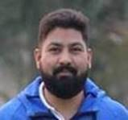
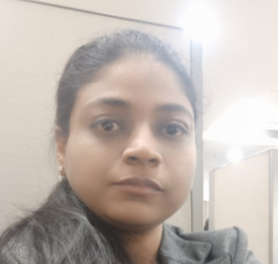
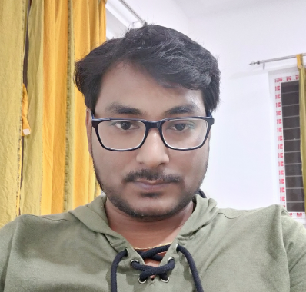
A big thank you from – Tes Amis!
(your friends ☺)
Abhishek Chowdhury
Rakhee Srivastava
Debabrata Behera

